Slide 1

Data Visualization Final Project
Ricky Chen, Yifei Ren, Halle Steinberg, Robert Wei

Slide 2




About Our Team
Halle Steinberg
Yifei Ren
Ricky Chen
Robert Wei
Producer
Director
Cinematographer
Lead Male Actor

Slide 3
AGENDA
01
Overview
02
Inspiration
03
Questions to Answer
04
Data Preparation and EDA
05
06
Implementation
Design
07
Insights and Self Evaluation
08
Further Improvement

Slide 4
01
We wanted to create a visualization that shines like the stars in Hollywood. To do this, we found a movie dataset that would allow us to visualize many different aspects of the movie industry.
Overview and Motivation
Our goals for our visualization were:
To determine if there is a relationship between a movie’s IMDb ratings and its gross revenue
To look at how the profitability of the movie industry has changed over time
To explore the connectedness within the Hollywood director/actor network
To provide movie lovers with an interactive and useful dashboard experience that allows for seamless exploration into the history of the movie industry

Slide 5
02
Robert is an avid movie fan with a collection of over 1000 DVDs - ask him about it! He is always talking about it!
The movie industry is one that has been around for over a hundred years, so there is a lot of data worth looking into
It has always been a staple in entertainment, so it is interesting to see how it has continued to evolve over the years
We also found inspiration in Tableau Public dashboards that have previously explored the movie industry and IMDb scores
As everyone else can probably agree, we had a really great time working on Social Networks HW4 assignment where we analyzed how collaboration between producers and actors influences innovation in the film industry . We wanted to keep this going by performing some of our own film industry network analysis!
Related Work and Inspiration

Slide 6
03
Questions to Answer
What questions are you trying to answer?
How important is revenue in predicting IMDb scores and vice versa?
What is the relationships between a movie’s budget and its gross revenue?
How does the actor and director network influence movie revenue?
How have IMDb scores for movies changed over time?
How did these questions evolve over the course of the project?
We originally wanted to look just into IMDb scores and financial metrics, but we then determined that the social network might be related to IMDb scores and revenue as well, so we decided to explore more of how the actors’ and directors’ connectedness plays a role in revenue and budget.
According to movie industry standards, a movie must earn at least three times its budget in order to pay back all movie expenses. We determined that when we compare this measure to a movie’s budget, there is a difference in the number of movies that meet this standard now, compared with in the past.
What new questions did you consider in the course of your analysis?
How does a director’s degree centrality relate to his/her average gross revenue? Eigenvector centrality? Does a more central director have higher revenue on average?
Is there a trend in profitability over time for different movie genres?
How do movies that are rated differently (based on content) vary in their gross revenue?

Slide 7
04
Data Preparation and EDA

Slide 8
Data Preparation
Source - https://data.world/data-society/imdb-5000-movie-dataset
Our data comes from data.world, and contains 5,043 observations and 28 variables, with each observation representing a movie with various characteristics
IMDb score
Director name
Top 3 actors in the film
Year created
Facebook likes for director and actors
Film gross revenue and budget
Movie genre
Data cleanup and augmentation
Split out column that included all genres a movie falls into, and used the first genre as the main genre
We also created an edge list in R of all directors and actors that are connected to each other by a movie they have worked on together
We explored network statistics at the actor and director level, calculating metrics such as degree, closeness, betweenness, etc., using the ‘igraph’ package in R

Slide 9
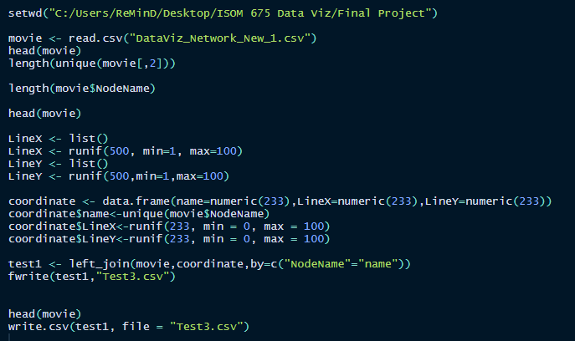
Data Preparation for Relationship Network Graph
We first separated every single movie record into 6 relationships based on the director of the movie and the actors in it
Created an edge list for further use
We copied the edge list twice to assign random X/Y coordinates, making sure to keep them connected by using the same ID for each actor/director
One record was repeated 12 times so the dataset is 12x bigger than it used to be
We then explored how to create a network graph object in Tableau using a R script
We assigned each director/actor a unique and random X/Y coordinate that we then used to plot into a network graph object in Tableau
Each node has its own unique coordinate while the same node shared the same coordinate, with a path indicating a relationship between one director/actor and another
Assigning coordinates was the hardest part of this work
We tried many techniques including but not limited to: Neo4J, Python, and SQL
Some of them worked, more or less, while some of them did not - the R script here ended up being the most straightforward way of getting the result we wanted
To get network statistics, we used the edge list we created earlier to make an igraph object, and computed the following for each director/actor:
Degree centrality
Closeness
Betweenness
Eigenvector centrality
R Script

Slide 10
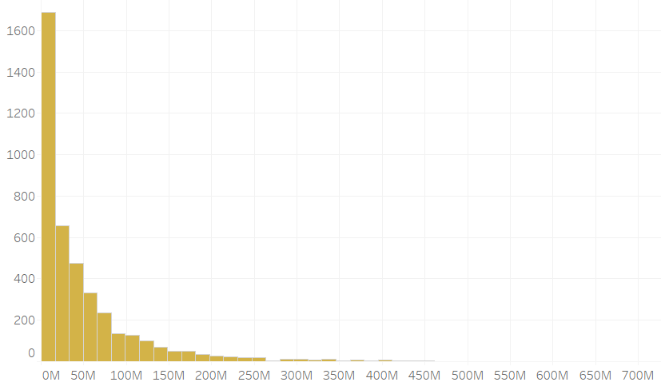
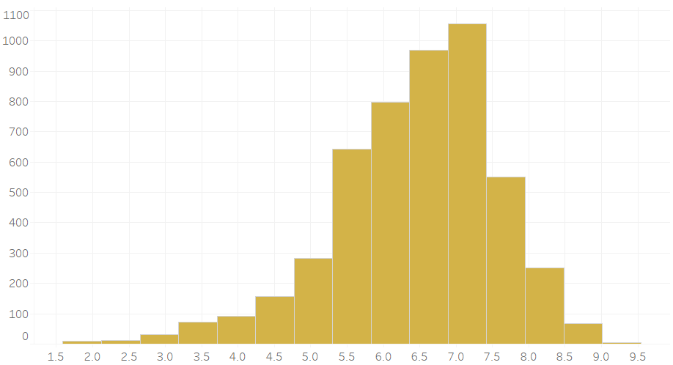
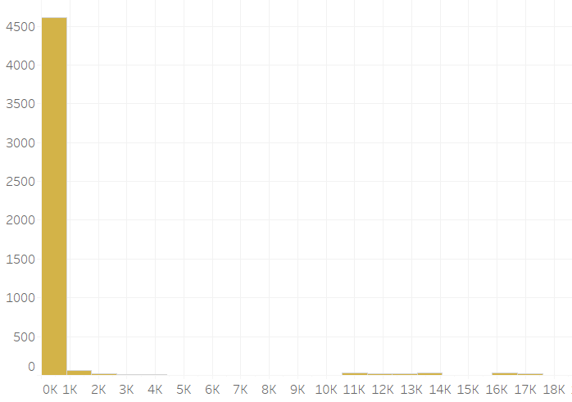
Exploratory Data Analysis
We created simple histograms to show the distributions of movie gross revenue, IMDb scores, and director’s Facebook likes
We found that gross is right skewed, IMDb has a fairly Normal distribution, and Facebook likes is strongly right skewed
Gross
IMDb Score
Director’s Facebook Likes

Slide 11
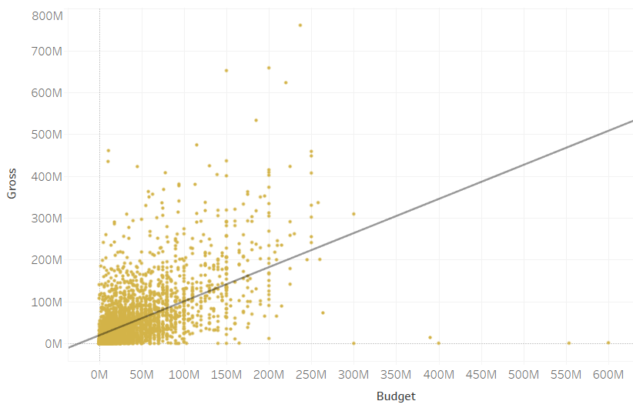
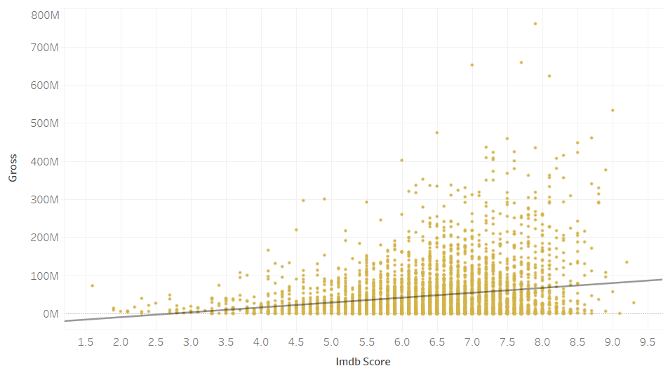
Exploratory Data Analysis (continued)
We used scatter plots paired with trend lines to show any possible correlations between variables
We found that gross has a positive relationship with budget and IMDb scores, but there is no obvious relationship between gross revenue and Facebook likes
To capture network influence on gross revenue, we calculate social network statistics for our visualization in order to find director influence on movie gross
Gross vs Budget
Gross vs IMDb Score

Slide 12
Exploratory Data Analysis (continued)
To dive into the relationships between budget, gross revenue, and IMDb scores, we looked into how these relationships change over time and found that there is a downward trend in IMDb scores
We explored how budget, gross revenue, and IMDb scores differ across movie genres, content ratings, and producers’ nationality
To explore the relationship between budget and gross revenue, we calculated a profit margin based on industry standards
According to industry standards, for a movie to be considered profitable, the gross revenue needs to be at least 3 times its budget, so we created a variable to capture this ratio

Slide 13
05
Design

Slide 14
Design Evolution - Dashboard 1
We showed over years, how the ratio between gross revenue and budget changes in different movie genres - we use green to represent when gross is more than three times a movie’s budget, yellow is between three times and one time, and red is less than one time.
We chose to use hue to differentiate between our three categorizations for profit ratio, as well as intensity to represent the magnitude within each category
We created a scatter plot of all movies’ budget and gross revenue and colored the points by gross revenue/budget ratio as above, and added a step reference line to divide the plots into two categories of profit or not
We chose dots to represent each individual movie, and used the same color scheme as above
We made a bullet chart to show average gross revenue of different movie content ratings, and added a bullet mark to represent a goal gross revenue for each content rating based on its average budget

Slide 15
Design Evolution - Dashboard 2
For the IMDb movie ratings, we wanted to explore IMDb scores by country, genre, the relationship between IMDb scores and revenue, as well as the time trend of IMDb scores
We created a map to best represent all the countries and their average IMDb scores
We used a diverging color scheme (intensity) in this map to represent the difference in magnitude of each country’s average IMDb score
In order to provide more information about the country’s individual movies, we added a tooltip for each country containing a graph showing the relationship between gross revenue and budget of each movie produced in that country
To show the basic statistics of IMDb scores by each genre, we created a boxplot with median, maximum and minimum labeled foreach genre
We used a box plot to show the distribution of scores within each genre, with each point in the distribution corresponding to an individual movie in that genre
We used a scatter plot to show the relationship between IMDb scores and gross revenue, with each point representing an individual movie in the plot
We added a trend line to show the positive relationship between the two variables
Since the relationship between year and average IMDb scores is a time series, we used a line chart to represent the change in scores throughout all of the years in our data

Slide 16
Design Evolution - Dashboard 3
We designed a social network graph, inspired by Social Network homework, to explore how the relationships between directors and actors evolve over time
We created a dual axis chart, and placed randomly generated X-coordinates on columns and two y-coordinates on rows, with one set to line and the other was set to be circle
We added Movie Year into pages to look at how the relationships among directors and actors formed year by year
We also created two scatter plots to explore the relationship between a director’s centrality and his/her average gross revenue
We used a dot to represent the average gross revenue for each director, averaged across all of his/her movies, and his/her degree centrality or eigenvector centrality
The last part of this dashboard is simply a web browser linked to Wikipedia - the user can click on any dot in either scatter plots or the network graph and be prompted to click on a link to be taken to that actor or director’s page

Slide 17
06
Implementation

Slide 18
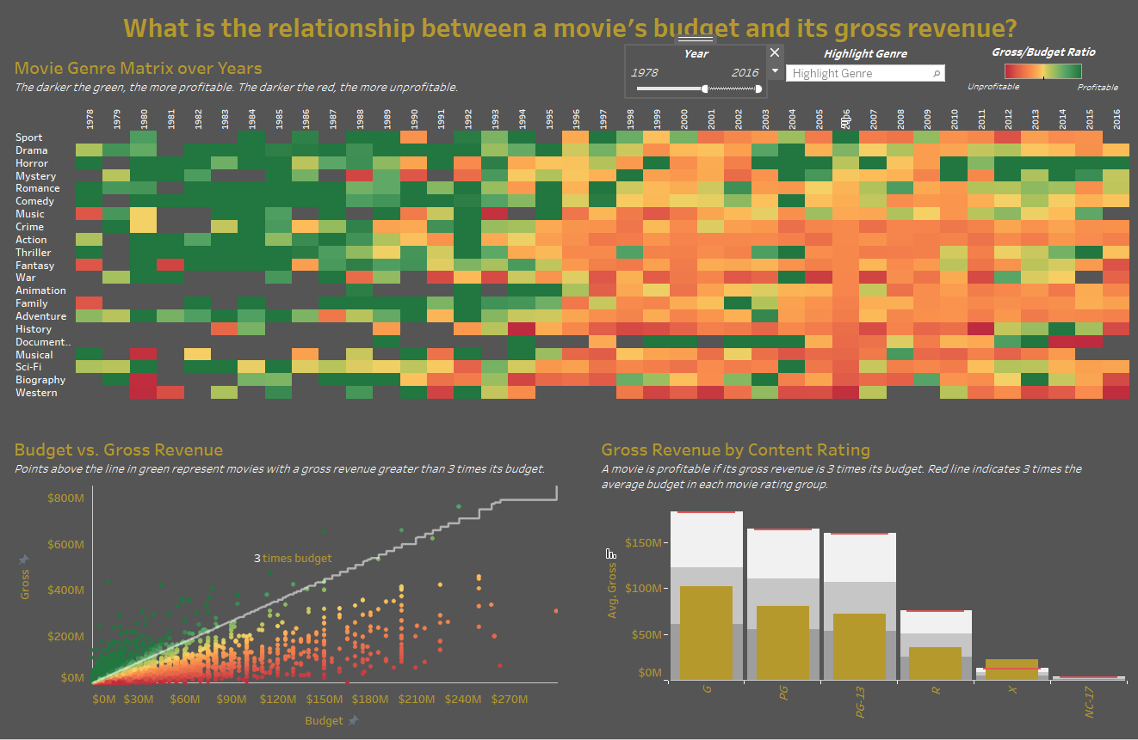
Implementation Dashboard 1
1. The data in the heat map can be filtered using the Year filter at the top to show only data within a certain timeframe or year.

Slide 19
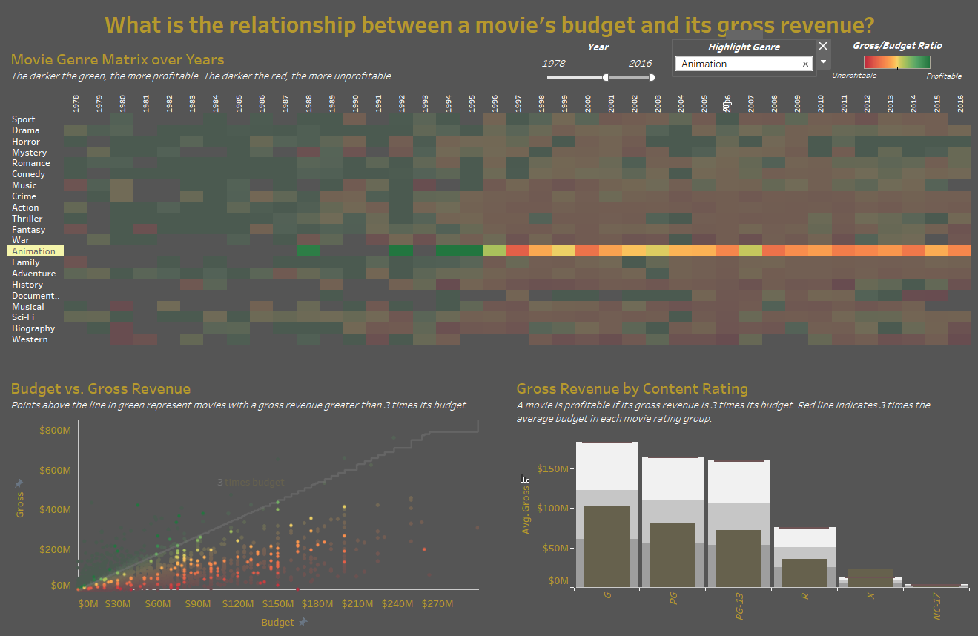
Implementation Dashboard 1
2. The highlighter can be used to highlight a specific genre you might be interested in so you can look at that genre’s trend over time.

Slide 20
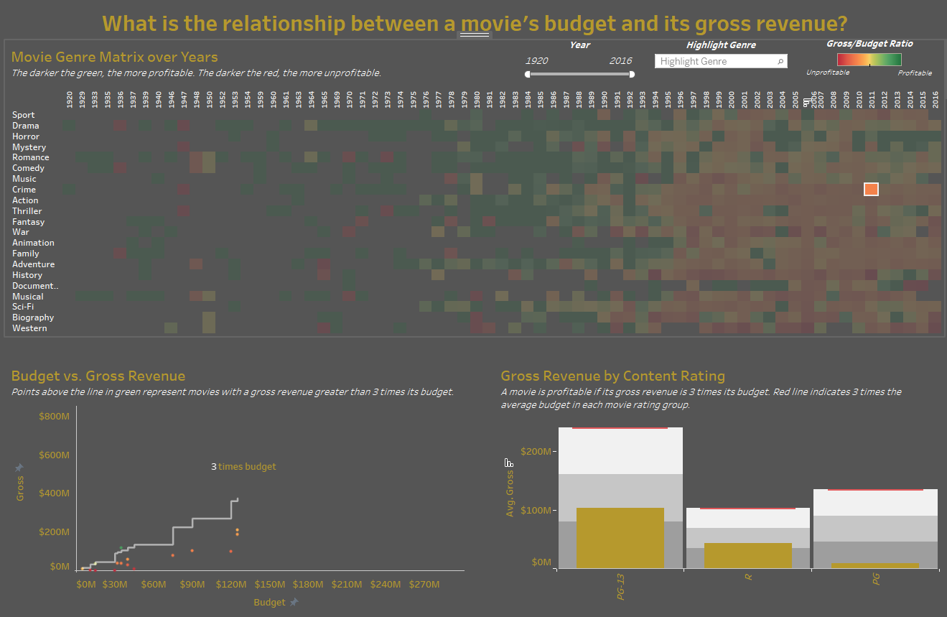
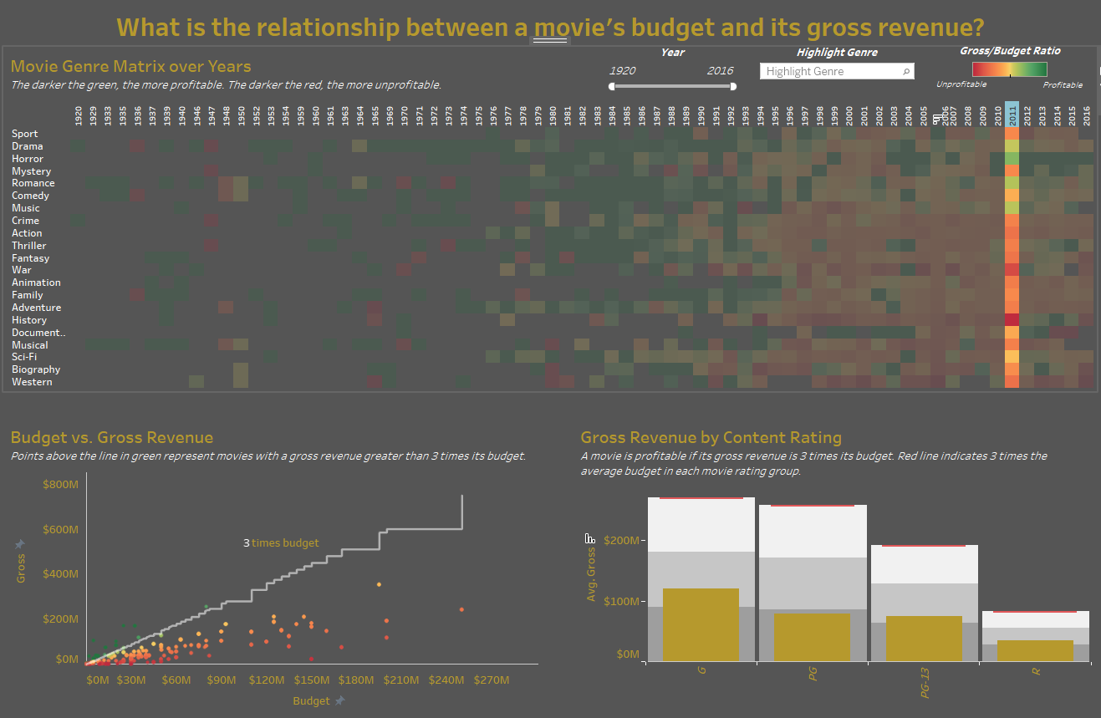
Implementation Dashboard 1
3. Clicking on any square in the heat map filters the data in the other two charts to show only data related to that year and genre.

Slide 21
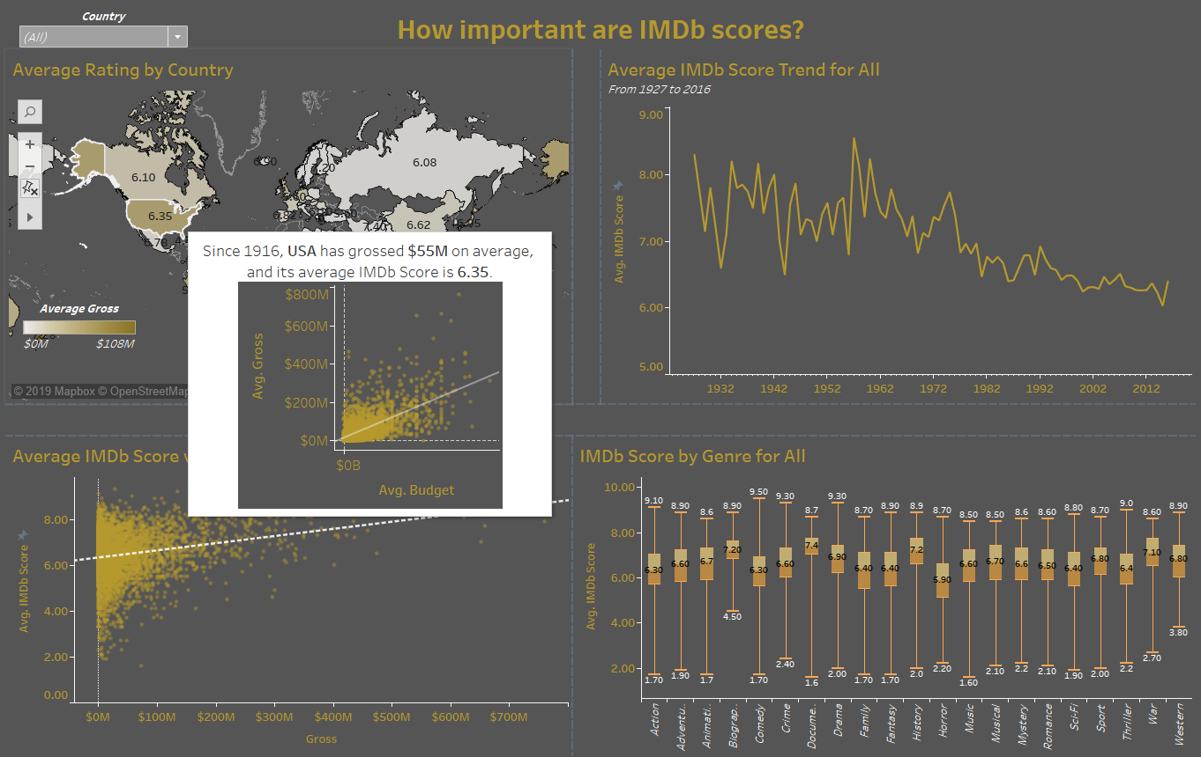
Implementation Dashboard 2
1. Hovering over a country in the map shows a tooltips containing a plot that shows the relationship of gross revenue and budget for that country’s movies.

Slide 22
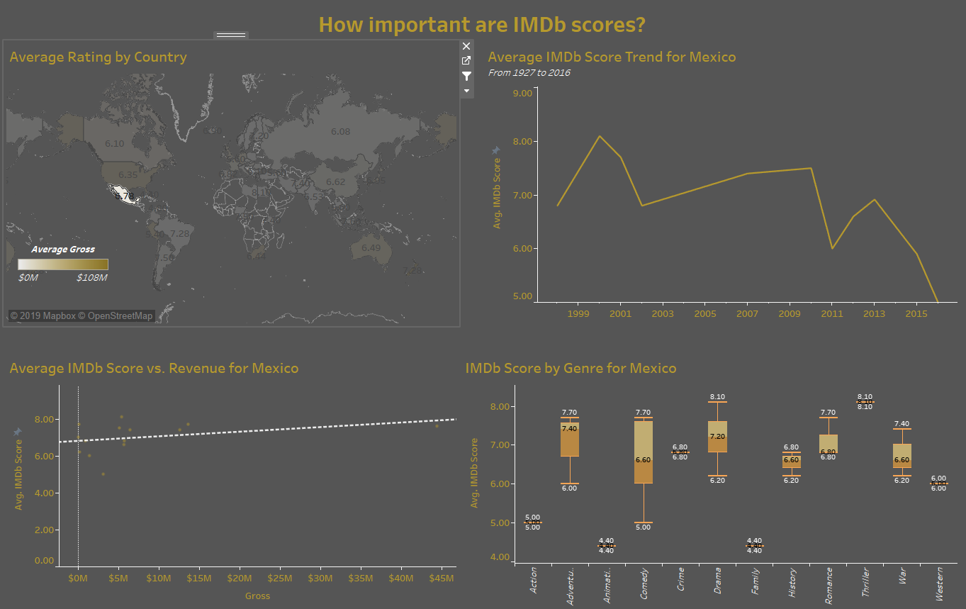
Implementation Dashboard 2
2. When clicking on a country in the map, the remaining three graphs will be filtered to show the corresponding country’s movies.

Slide 23
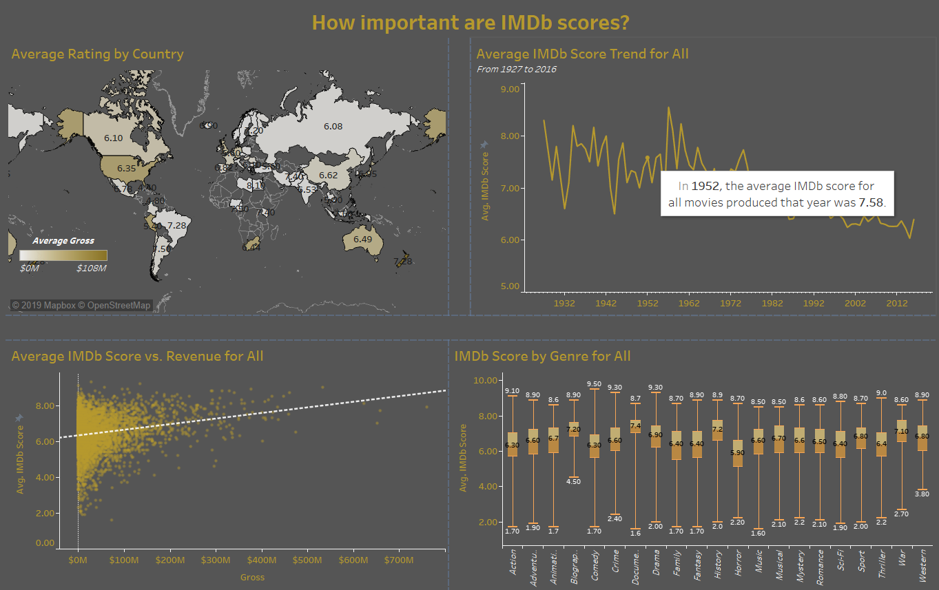
Implementation Dashboard 2
3. The tooltip in the time trend plot shows the year and the average IMDb score in that year.

Slide 24
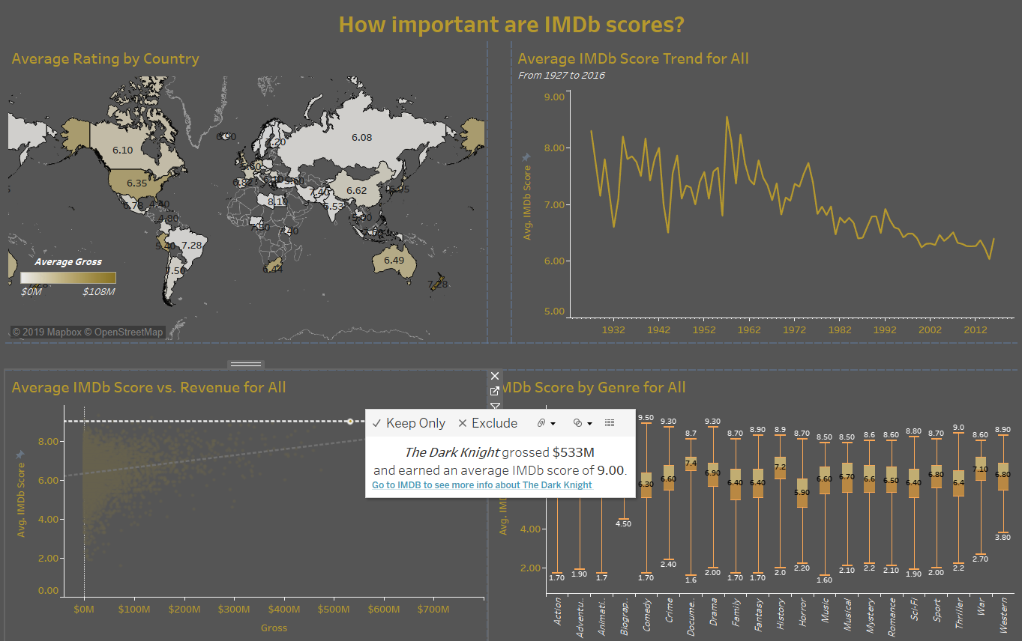
Implementation Dashboard 2
4. When clicking a certain point in the IMDb score vs. gross revenue plot, it shows the movie name, how much it grossed and its IMDb score. Also, you can click on the link to go to the movie’s IMDb webpage.

Slide 25
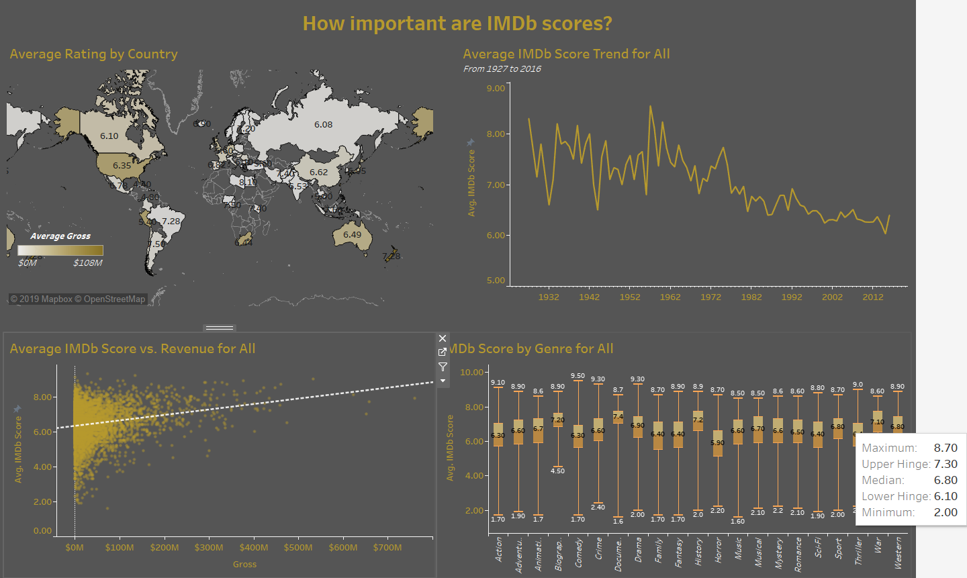
Implementation Dashboard 2
5. When hovering over the boxplots in the IMDb scores by genre plot, the tooltip shows the statistics of corresponding genre’s IMDb scores.

Slide 26
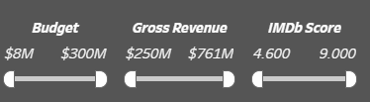
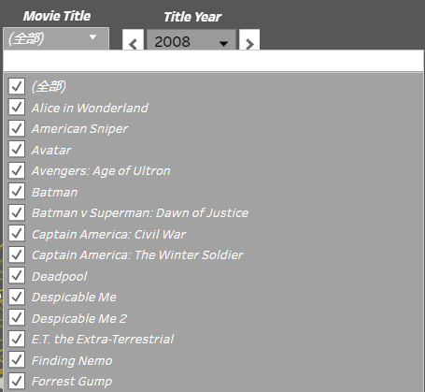
Implementation Dashboard 3
1. Filters could help users narrow down the network complexity and look at specific features they are interested in such as different budgets, gross revenues, and IMDb scores.
2. A drop down box enables users to select their favorite movie and See how the actors and directors in their favorite movies are connected.

Slide 27
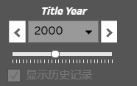
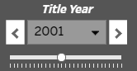
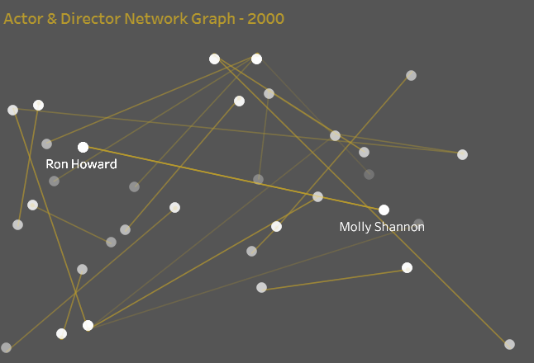
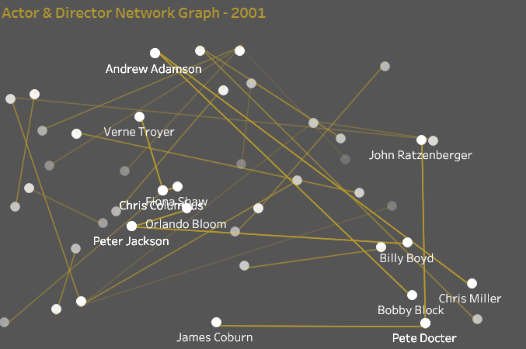
Implementation Dashboard 3
3. A year selection bar allows users to explore in detail how the director/actor network in Hollywood develops over time. Since all of the history in the network is stacked up, older records will be dimmer while newer records will be a brighter white.

Slide 28
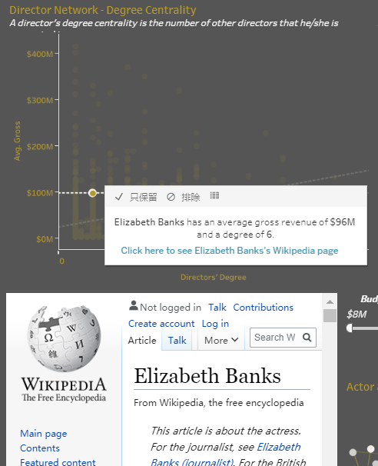
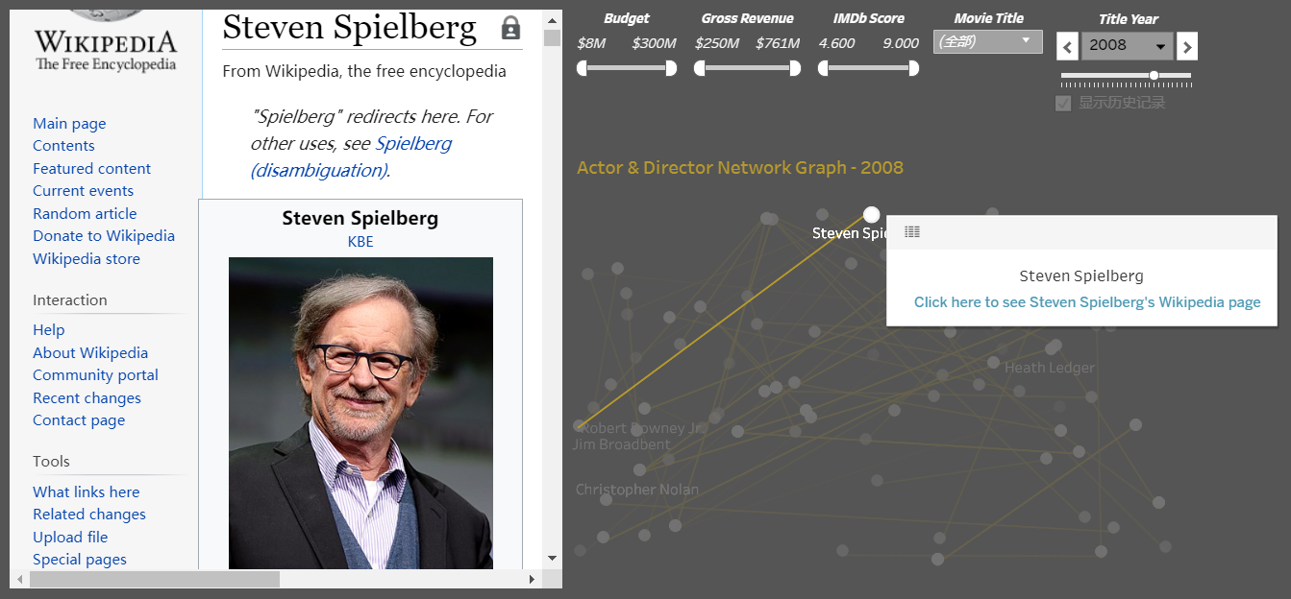
Implementation Dashboard 3
4. Lastly, we have a Wikipedia page link for every director and actor in the tooltip for both charts on the top and the network graph. By clicking the blue link of any person, the Wikipedia page will automatically show on the left bottom of the dashboard.

Slide 29
Determine if there is a relationship between a movie’s IMDb ratings and its gross revenue:
In the IMDb score vs. gross revenue plot on the IMDb scores page, we can see a positive slope between the ratings and the revenue, considering all movies. Generally speaking, higher gross revenue means higher IMDb scores.
Also, in the IMDb scores page, we can evaluate the IMDb scores trend and see each genre’s IMDb scores filtered by country, which gives us a better understanding of the IMDb scores.
Look at how the profitability of the movie industry has changed over time:
In the gross revenue/budget ratio heat map in the gross/budget page, we can see more and more red and yellow squares appear as time goes by, indicating movies are becoming more unprofitable over time.
Also, in the same page, the gross revenue vs. budget scatterplot shows that movies with a lower budget struggle to earn high profits. In the gross revenue barplot by content rating, we can see that profitability also varies based on content rating, with movies that are less suitable for all audiences (R, X, NC-17) being less profitable in general.
Explore the connectedness within the Hollywood director/actor network:
We created a network graph in the network page to show the director/actor co-operation relationship. By filtering to a different title year, we can see new relationships between directors and/or actors being created each year. Also, the top two graphs show the average gross revenue of a certain director’s movies related to the director’s centrality, indicating that, in general, the relationship between a director’s connectivity within the network and his/her average gross revenue is positive.
07
Insights and Self Evaluation

Slide 30
08
Add weight to the lines/connections of the network graph to define whether a connection between one actor/director and another is weak or strong
When we have a weighted connection, we would then be able to filter the actor/directors by how strong of a tie he/she has
Update our dashboards so they are closer to present day
We could collect more data for international movies across the globe, since most of our data comes from USA
Gather recent movie data and IMDb ratings to evaluate whether some of our trends are still valid or if there are new conclusions forming
Further Improvement

Slide 31
THANK YOU

Slide 32
Sources
Dataset from: https://data.world/data-society/imdb-5000-movie-dataset

